Slide 1

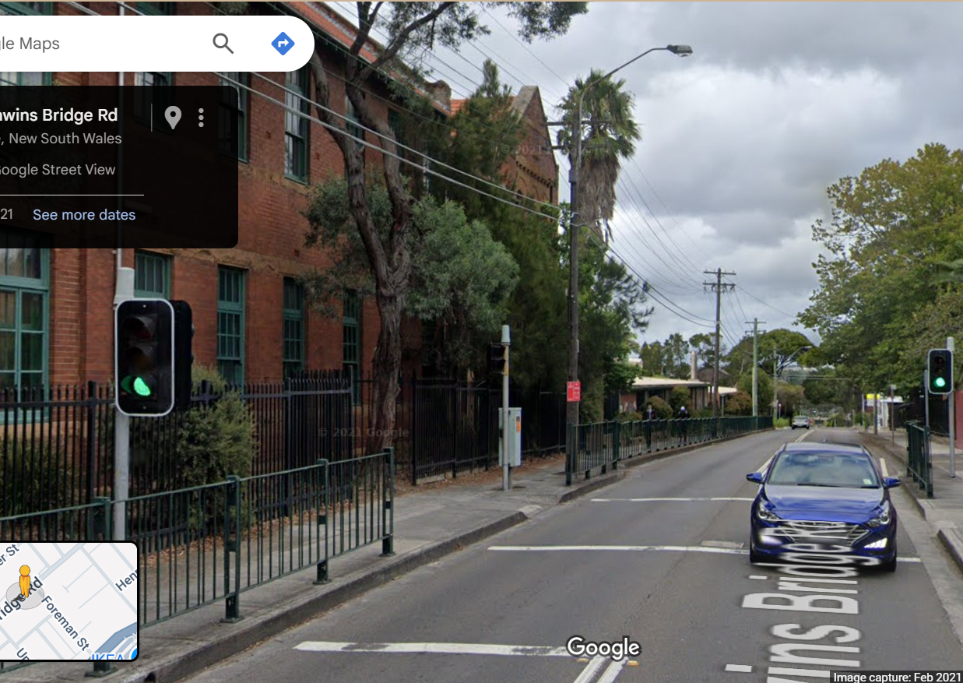

Pi Pico OOP Mini Project
Ben Jones
Tempe High School
Lecture 0
Notes:
This lecture series and its projects focuses on the fundamental concepts of the Object Oriented Paradigm and Raspberry Pi Pico Microcontroller.

Slide 2
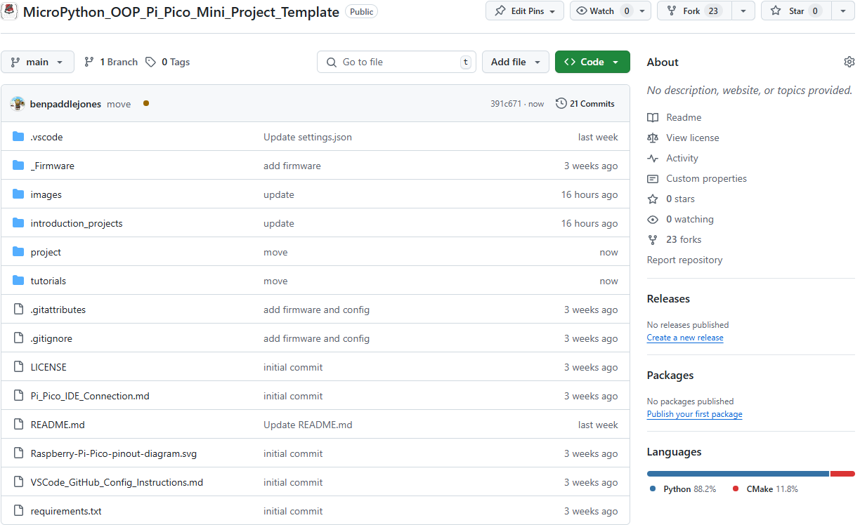
Fork Repo
Pi Pico Firmware
Instructions for
Introduction Projects
VSCode Project Folder
Preconfigured for Pi Pico Extension
Text Instructions for
OOP Mini Project
Pi Pico IDE Connection
Notes:
This is the source repository
Please fork the repository to your own github account
This folder contains the firmware and nuke unbricking firmware
This folder contains the documentation for the introduction projects
This folder folder is pre-configured for Pi Pico development is VS Code
This folder contains details on the concepts covered in these video tutorials
This file has help for connecting Pi Pico to different IDE’s

Slide 3
IDE
Wokwi
https://wokwi.com/
Arduino Lab Web Based IDE
https://lab-micropython.arduino.cc/
Thonny
VSCode
Codespaces
Note:
This repository is optimised for VSCode.
I will Model both VSCode & Wokwi in this series.
See Pi_Pico_IDE_Connection.md for help with IDE’s and connection.
Notes:
The Pi Pico is compatible with a variety of IDEs. In these lectures, I will be demonstrating both Wokwi and Visual Studio Code (VSCode). While you can write code in GitHub Codespaces, please note that it cannot be used to upload code directly to the hardware. To work with the Pi Pico in VSCode, you’ll need to install the Pi Pico Extension.

Slide 4
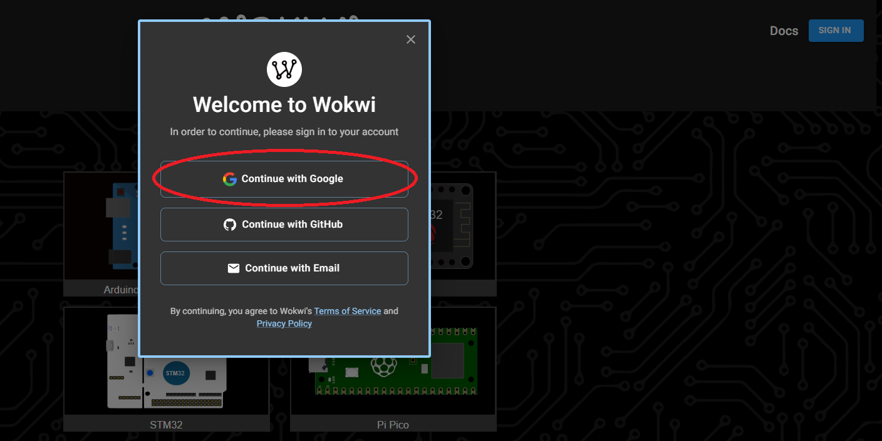
Wokwi https://wokwi.com/
Notes:
Wokwi is an online simulator and IDE that you can use for simulations and unit testing. All of these projects, including the OOP Mini Project, can be completed in Wokwi. However, to further develop your skills, I encourage you to physically build the circuits on a breadboard if possible.

Slide 5
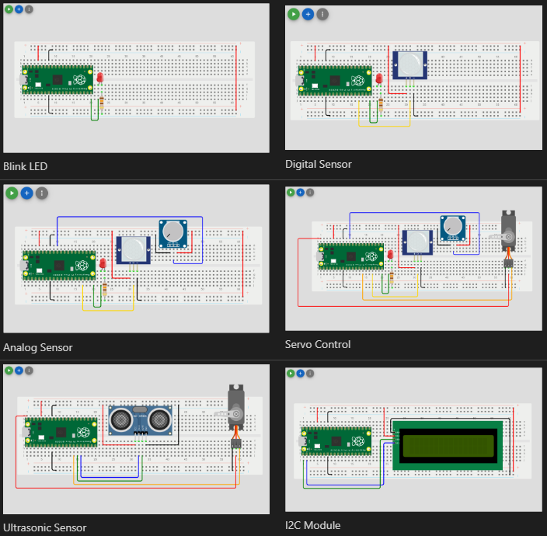
Introduction Projects
Notes:
The introductory projects are your first task after watching this video. Please follow the written instructions to build each project. You can find these instructions in the "introduction projects" folder of your repository.

Slide 6
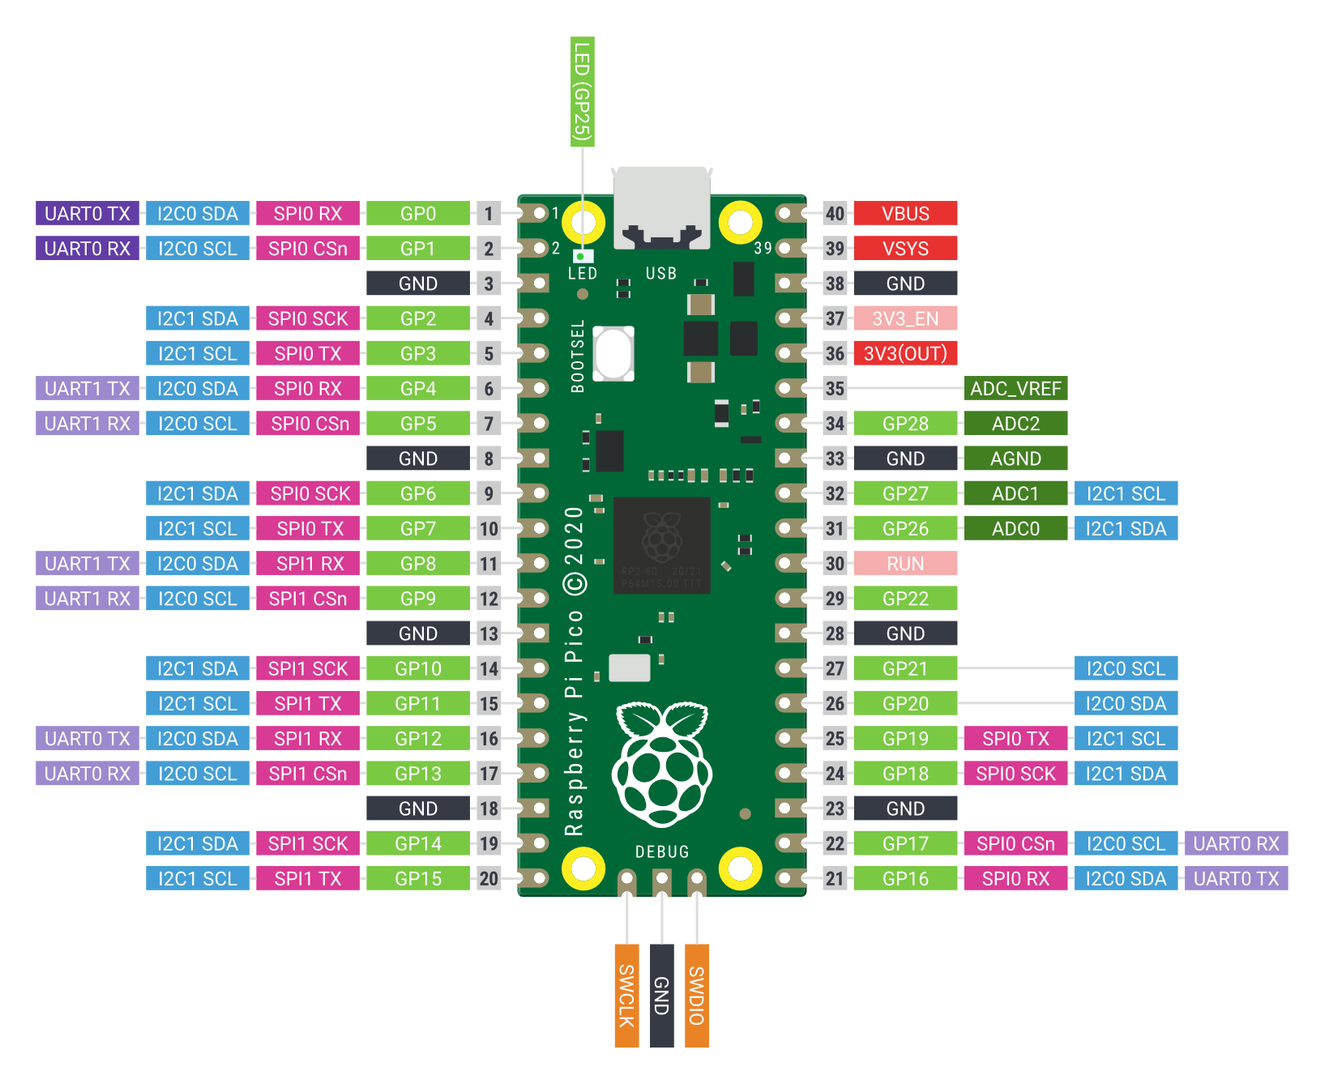
Common Mistakes
Incorrect polarity on an LED.
Not uploading the 2IC Libraries either to the Pi Pico or to Wokwi.
Programming GPIO Pin 3 but wiring to the 3rd Pin not GP3.
Connecting to the wrong row on a breadboard.
Connecting an analogue sensor to the GND rather than the specific analogue ground AGND.
Overcurrent as the Pi Pico and most sensors are 3.3v sensitive. Only motors should be connected to the VBUS (5v). If a sensor is connected to the VBUS, it will return 5V to the GND, causing an overcurrent situation.
Notes:
Be aware of the following common mistakes, which you may encounter:
Incorrect polarity on an LED by wiring it backwards. Ensure the longer leg (anode) is connected to positive.
Not uploading a required library (such as I2C) to the hardware or adding the file to Wokwi environment.
Programming a GPIO Pin 3 for example but mistakenly wiring to the third physical pin instead of GP3. Always double-check the pinout diagram.
Failing to connect an analog sensor to the analog ground (AGND).
Causing an overcurrent on a sensor. The Pi Pico Pins and most sensors are sensitive to 3.3V; only motors should be connected to VBUS (5V).
Regular checks with the pinout diagram will help you avoid most of these issues.

Slide 7
Simple Open Loop Control System
Can you see the controller?
Notes:
The Mini Task is to model this control system using the Object-Oriented Paradigm. The light blue box is the actual controller, which is typically a digitally controlled mechanical switched control system.

Slide 8
Notes:
This animation demonstrates the prototype operating as a complete system. You’ll see that pressing the button triggers a change in the control system’s state. The system then cycles through a series of states before eventually returning to the idle state.
26sec

Slide 9
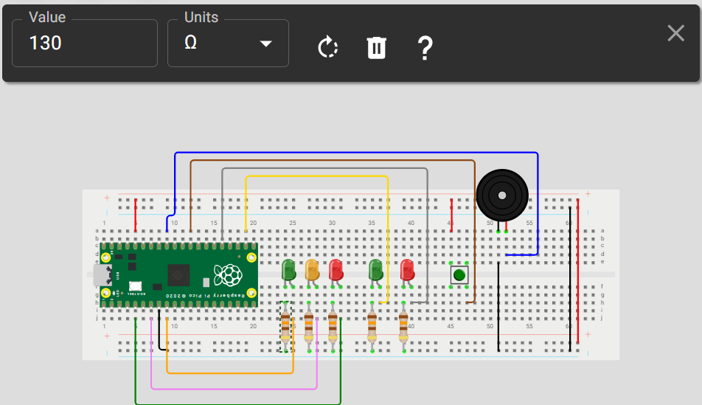
Components
Breadboard
15x Jumper leads
Pi Pico
1x Momentary switch
5x LED
1x Piezo buzzer
5x 130Ω resistors
Notes:
These are the components you will need if you choose to physically build the circuit, which is recommended. Make sure to gather all the necessary components before you begin. If you are using Wokwi, remember to change the resistors to 130Ω; otherwise, the resistance will be too high and the LEDs may not illuminate properly.

Slide 10
Pin Allocation
Pin
GP3 | Red LED
GP4 | Keyboard Interrupt
GP5 | Amber LED
GP7 | Red LED
GP17 | Flashing Green LED
GP19 | Flashing Red LED
GP22 | Button signal
GP27 | Piezo Buzzer
GND | Circuit Ground
3V3 | Button logic voltage
Notes:
These are the Pi Pico pins allocated for this project. For consistency and to make following the project easier, it is recommended that you use these specific pins.

Slide 11

When you see this symbol,
press pause and implement it!
Notes:
Throughout these tutorials, whenever you see this pause symbol, it indicates that you should pause the video and take a moment to implement the task or activity described.

Slide 12
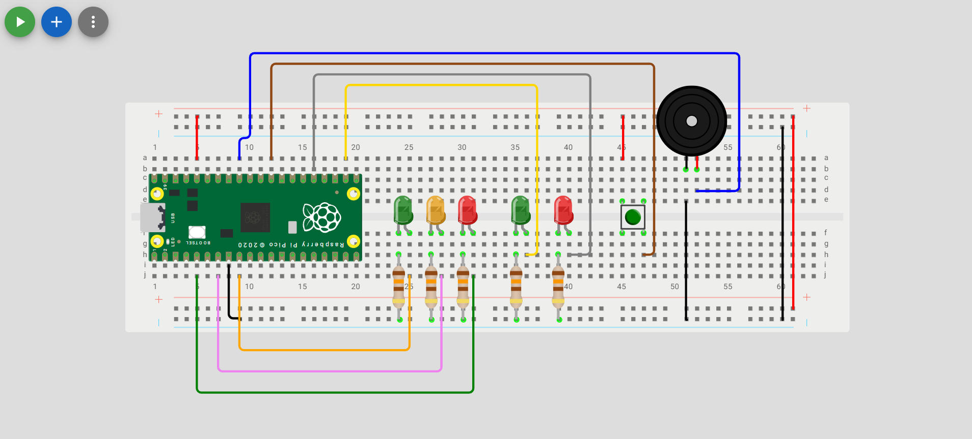
Wiring
Notes:
Now, it's time to press pause and wire your project. Once you have finished wiring, you’ll be ready for Lecture 1, where we will begin by unit testing your prototype.

